Slide 1
Why and When will Leaders of Developing County Negotiate South-North Preferential Trade Agreements?
Lucie Lu
Department of Political Science
September 19, 2018
Notes:
Hi

Slide 2
Research Question
Empirical Puzzle: Preferential trade agreements (hereafter PTAs) negotiation between South Africa and the EU in 1994
Research Question: Why and when will leaders in the developing country negotiate South-North preferential trade agreements with provisions of economic reforms?
Why important?
South-North PTA is rapidly growing.
Power imbalances between S-N reflect their political costs and motives.
Contributes to a larger debate: do PTA change leaders’ behaviours, or leader self-select into the treaty?

Slide 3
Context and Rationale
PTA is an international institution.
Two themes in the literatures:
Effects vs. Causes of PTAs.
What are the gaps in the literature?
Treat PTA as unit of analysis.
➔ Focus on the deepest and costly subcategory of PTAs.
Overlook a key actor
Literature only looked at median voters¹, interest groups², and private sectors³ matters.
➔ Opposition matters.
1. Mansfield & Milner, 2012; Mansfield, Milner, & Rosendorff, 2002.
2. Grossman and Helpman, 1995.
3. Staiger & Tabellini, 1999.

Slide 4
Argument
Leaders negotiate PTAs after political crisis: A leader negotiates a PTA with the provision of economic reform to punish the opponents’ past transgression.
PTA negotiation is a deliberate choice that a leader makes to commit to the binding and stringent policy reforms to rearrange the domestic power structures.

Slide 5
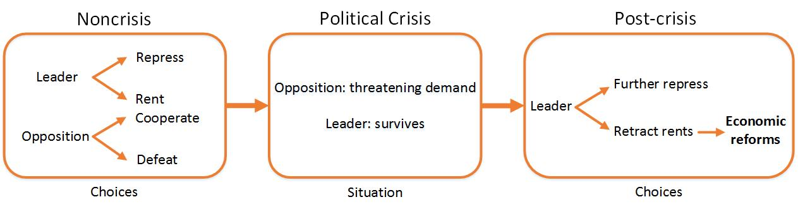
Theory
The Logic of Economic Reforms
(II) Why negotiating a PTA with major liberal powers?
PTA as a signal: ↑ leader’s commitment, ↓ opposition’s deposition
PTA as a mechanism to redistribute rent:
Disloyal opposition Loyal opposition
Reform
Reform
Side-payment

Slide 6
Research Design
Hypothesis:
Negative shocks to a leader's security increase the probability of PTA negotiations.
(Hypothetical Treatment)
Shock to Leader’s Security
+
South-North PTA Negotiation
Research Design:
Compares the likelihoods of the South-North PTAs negotiation in:
Leaders with Shocks to Security
Leaders without Shocks to Security

Slide 7
Research Design
Measure the Security of a Leader:
1) A leader's security before he starts his tenure at time 0 (Svolik 2012);
2) The security of the regime at time t (political effectiveness score in the state fragility index).
Identify Leaders who have Shocks to Security (Hypothetical Treatment):
Type 1: a leader experiences a shock to security at time 1.
political effectiveness score > 0.
Type 2: a leader experiences a shock to security at time t.
worsening political effectiveness score.

Slide 8
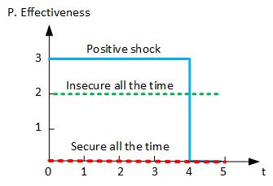
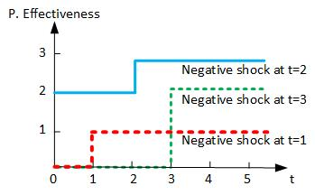
Who are Treated?
Control group Treated group

Slide 9
Examples in Datasets
Unit of analysis: Leader-Year
Country | Year | Leader | Regime | R.T. Past | P. Eff | PTA Nego.
Albania | 1997 | Fatas | Dem. | NA | 1 | 0
Albania | 1998 | Fatas | Dem. | NA | 2 | 0
Algeria | 1995 | Zeroual | Dict. | Regime | 2 | 0
Algeria | 1996 | Zeroual | Dict. | Regime | 2 | 1
Algeria | 1997 | Zeroual | Dict. | Regime | 2 | 0
Algeria | 1998 | Zeroual | Dict. | Regime | 2 | 0
Algeria | 1999 | Zeroual | Dict. | Regime | 2 | 0
Unit of analysis: Leader
Country | Leader | Tenure | Regime | R.T. Past | P. Eff | Shock(Z) | PTA Nego.
Albania | Fatas | 2 | Dem. | NA | shock_t | 1 | 0
Algeria | Zeroual | 5 | Dict. | Regime | shock_t1 | 1 | 1

Slide 10
Research Design
Unit of analysis is leader.
The dataset covers 286 leaders in 62 developing countries from 1995 to 2015.
Exclude liberal democracies
Exclude leaders whose tenure is less than one year
Dependent Variable: South-North PTA negotiation
Independent Variable: Negative Shocks to Security
Matching on the Covariates:
Regime Type (V-Dem’s Electoral Democracy Index)
Human Rights Conditions (PTS Score)
Regime Duration (Archigos, 2016)
GDP per capita (World Bank)
Confounding Variables in the OLS Model:
Leaders’ tenure (Archigos, 2016)
Negative Economic Growth (World Bank)

Slide 11
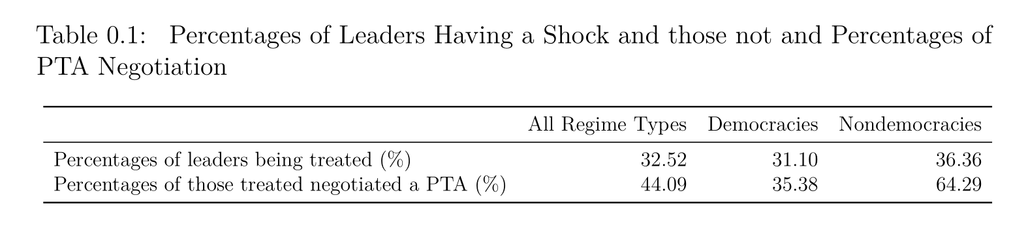
Empirical Findings: Data Description

Slide 12
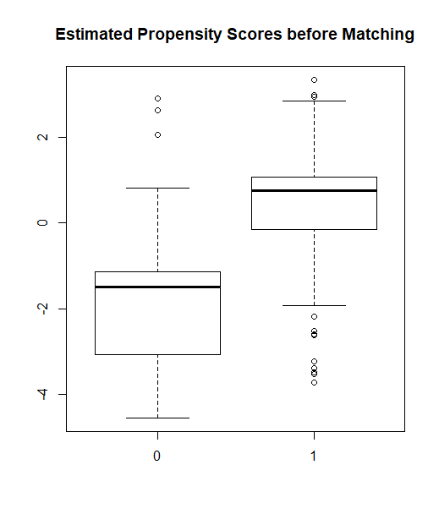
Empirical Findings: Propensity Score Before Matching

Slide 13
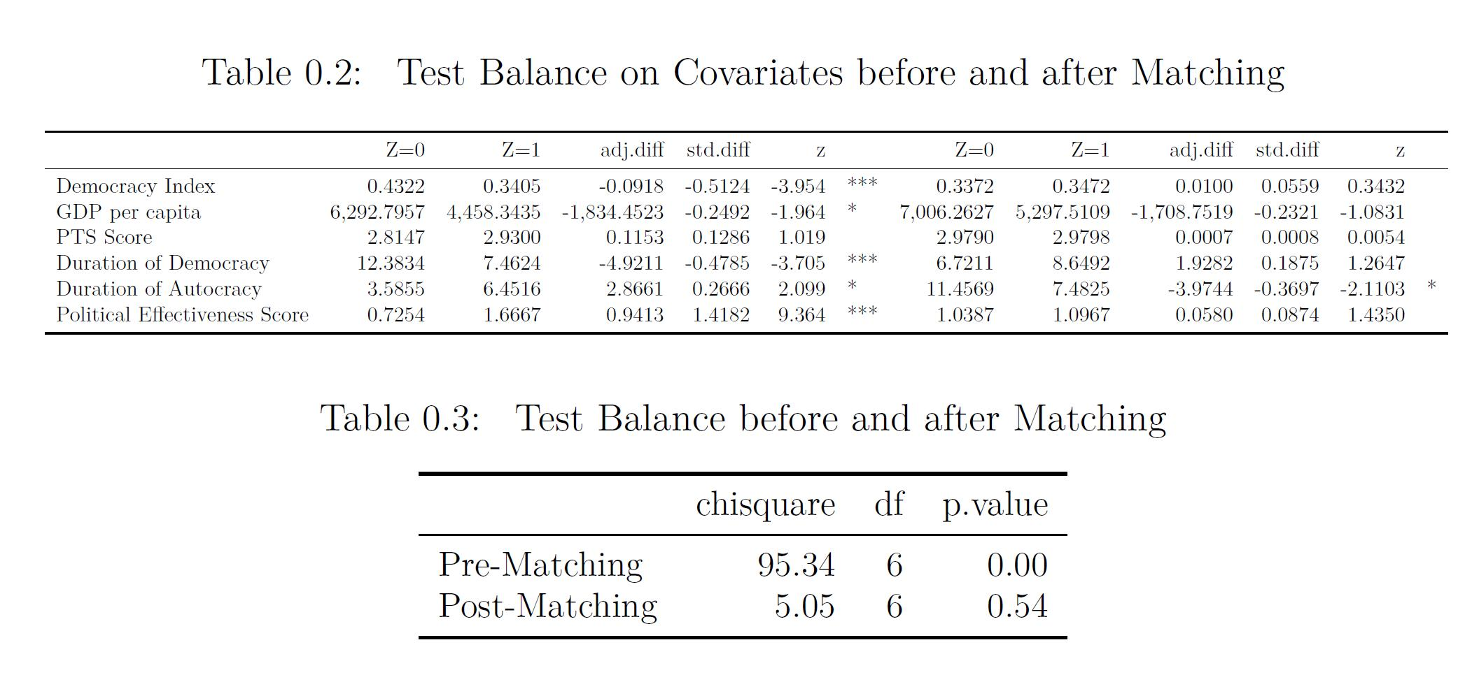
Empirical Findings: Propensity Score After Matching

Slide 14
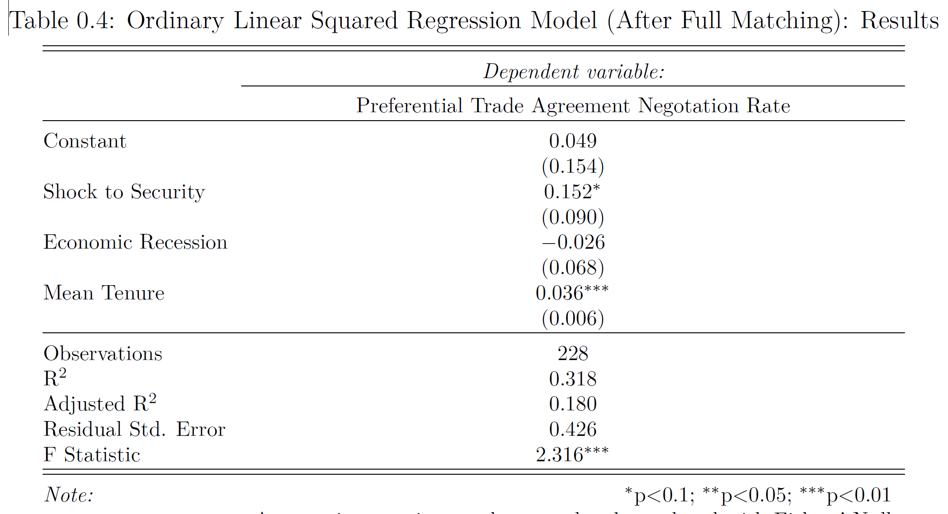
Empirical Findings: Treatment Effect After Matching

Slide 15
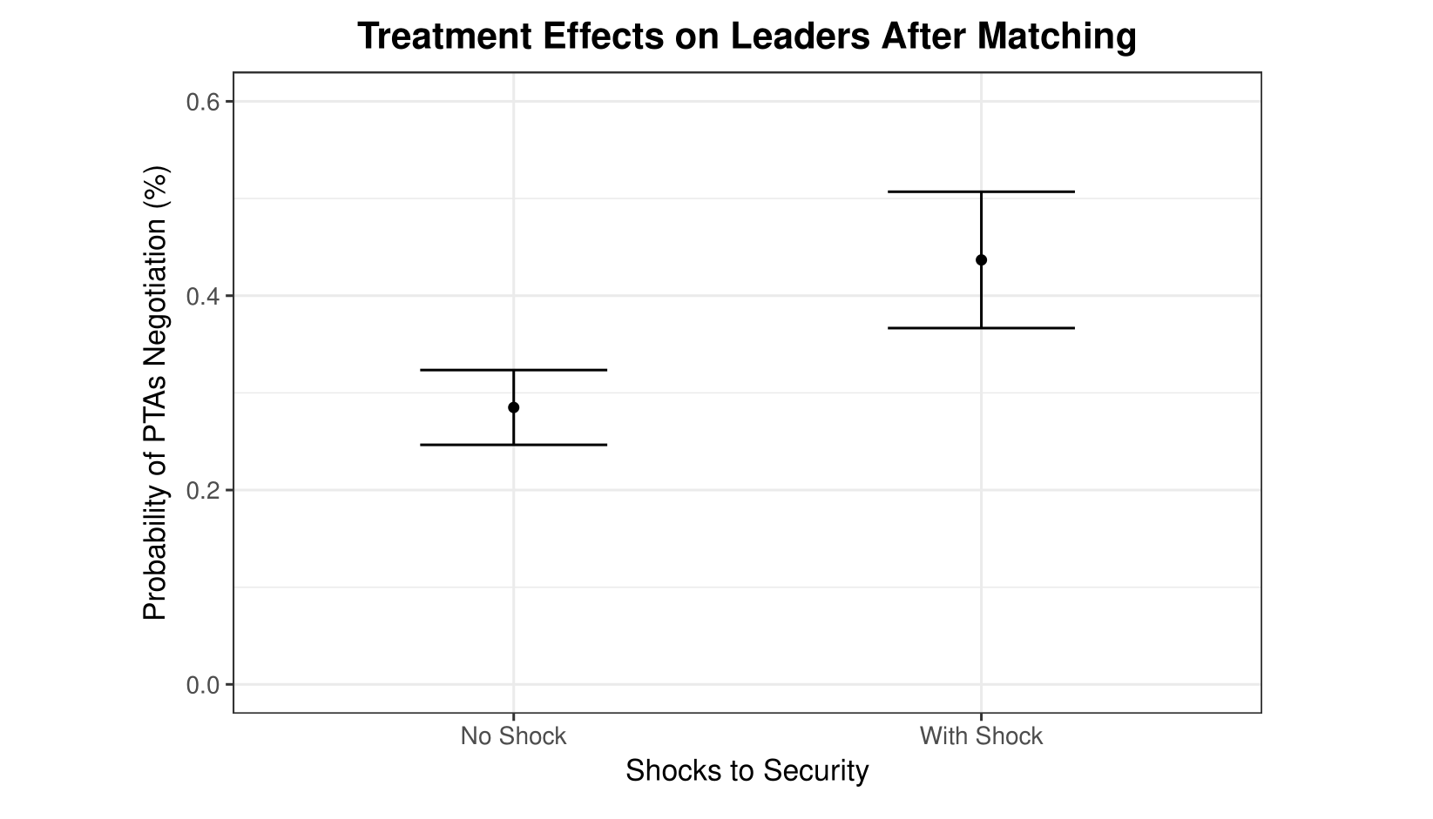
Empirical Findings: Treatment Effect After Matching

Slide 16
Conclusion
My hypothesis is empirically supported:
When leaders experience a political crisis, they are more likely to negotiate a South-North preferential trade agreement with the provision of economic reforms.
Moving forward:
Explore whether PTA negotiation helps leaders to conduct economic reforms.
Use a multilevel analysis to account for the nested structure of data variability.
Notes:
hello

Slide 17
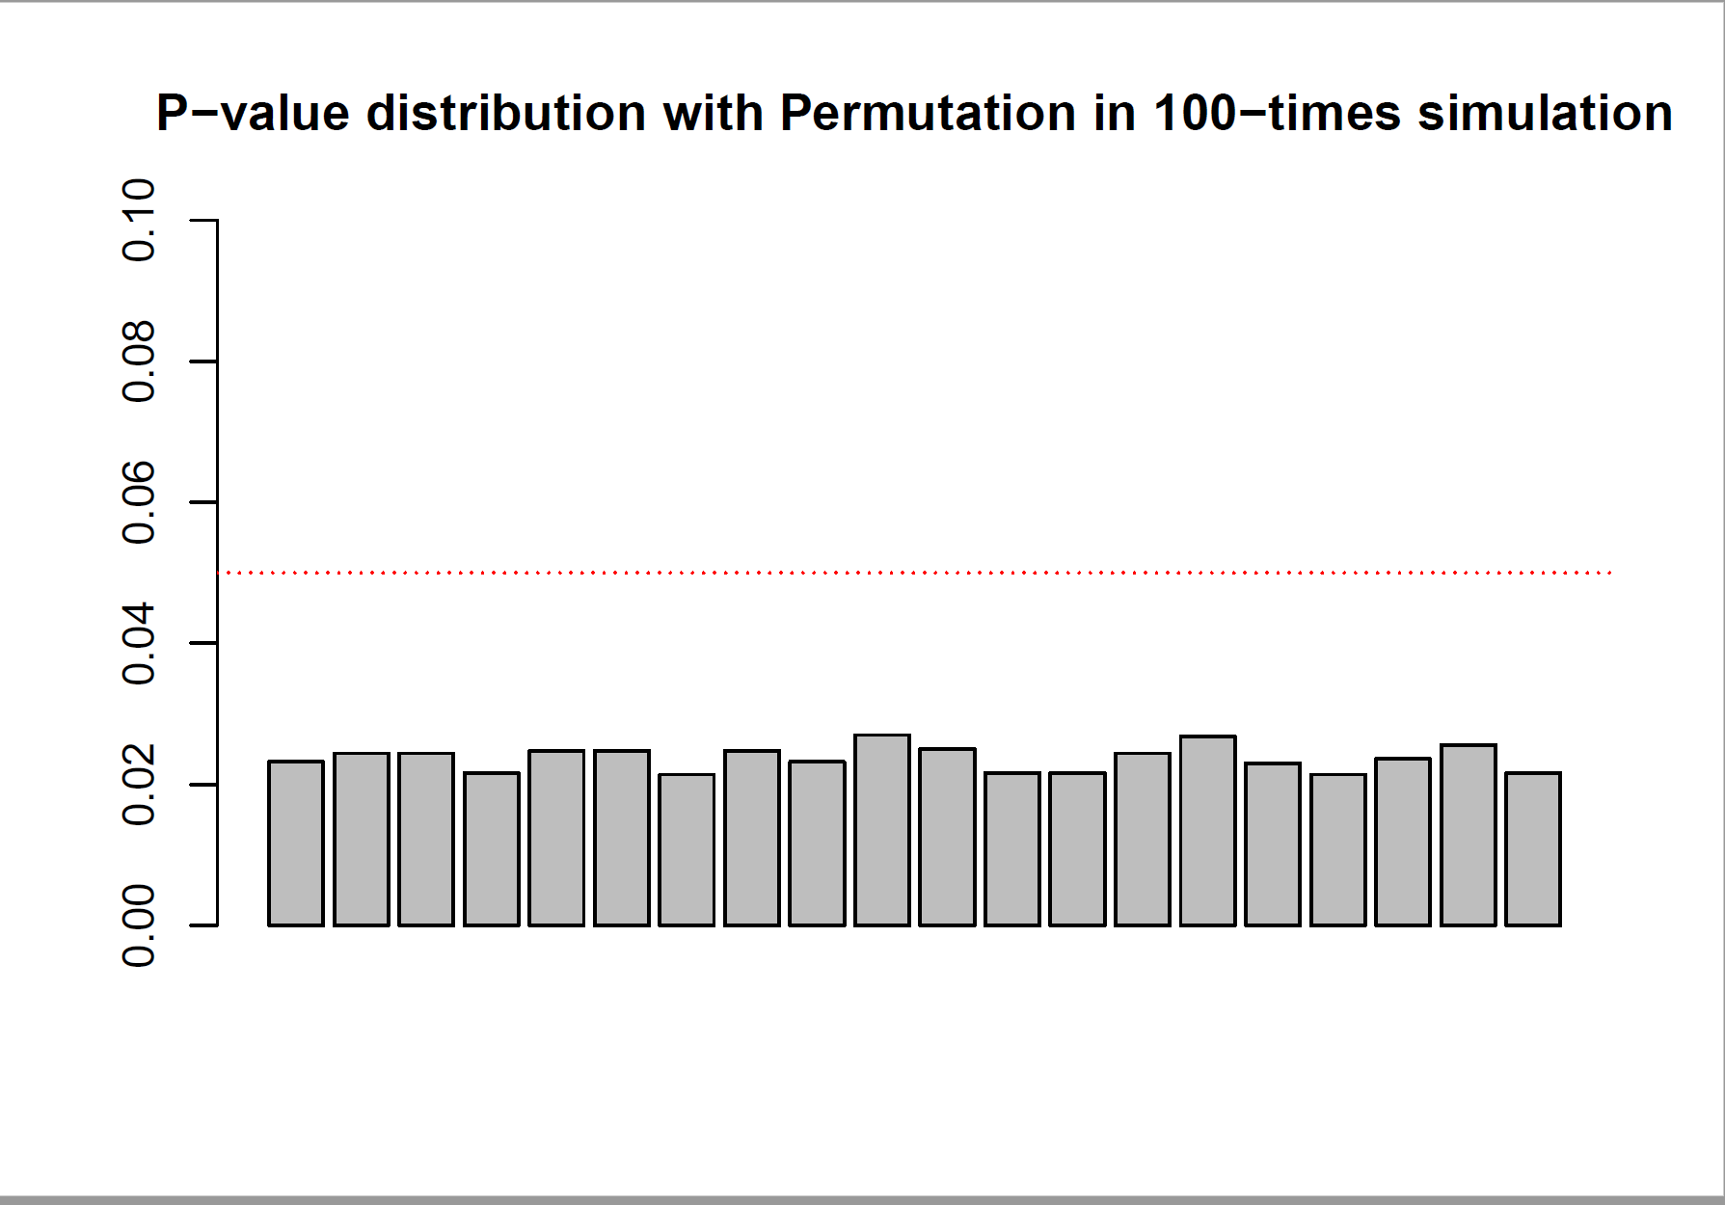
Appendix
Notes:
hello

Slide 18
References
Baccini, L., & Urpelainen, J. (2014). International Institutions and Domestic Politics: Can Preferential Trading Agreements Help Leaders Promote Economic Reform? The Journal of Politics, 76(1), 195–214. https://doi.org/10.1017/S0022381613001278
Bagwell, K., & Staiger, R. W. (1998). Will Preferential Agreements Undermine the Multilateral Trading System? The Economic Journal, 108(449), 1162–1182. https://doi.org/10.1111/1468-0297.00336
Baldwin, R. E. (2012). A Domino Theory of Regionalism. In G. Hufbauer & K. Suominen (Eds.), The Economics of Free Trade. Volume 2. (pp. 416–439). Elgar Research Collection. The International Library of Critical Writings in Economics, vol. 262. Cheltenham, U.K. and Northampton, Mass.: Elgar.
Bilal, S., & Laporte, G. (2004). How David Prepared to Talk to Goliath? South Africa’s experience of negotiating trade with the EU.
Dür, A., Baccini, L., & Elsig, M. (2014). The Design of International Trade Agreements: Introducing a New Dataset. The Review of International Organizations, 9(3), 353–375. https://doi.org/10.1007/s11558-013-9179-8
Grossman, G. M., & Helpman, E. (1995). The Politics of Free-Trade Agreements. The American Economic Review, 85(4), 667–690.
Kuran, T. (1991). Now out of Never: The Element of Surprise in the East European Revolution of 1989. World Politics, 44(01), 7–48. https://doi.org/10.2307/2010422
Mansfield, E. D., & Milner, H. V. (2012). Votes, Vetoes, and the Political Economy of International Trade Agreements. Princeton University Press. Retrieved from https://muse-jhu-edu.proxy2.library.illinois.edu/book/30505
Mansfield, E. D., Milner, H. V., & Rosendorff, B. P. (2002). Why Democracies Cooperate More: Electoral Control and International Trade Agreements. International Organization, 56(3), 477–513.
Mansfield, E. D., & Reinhardt, E. (2003). Multilateral Determinants of Regionalism: The Effects of GATT/WTO on the Formation of Preferential Trading Arrangements. International Organization, 57(4), 829–862.
Regan, P. M., & Henderson, E. A. (2002). Democracy, threats and political repression in developing countries: Are democracies internally less violent? Third World Quarterly, 23(1), 119–136. https://doi.org/10.1080/01436590220108207
Rodrik, D. (1992). The Rush to Free Trade in the Developing World: Why So Late? Why Now? Will it Last? (No. w3947). Cambridge, MA: National Bureau of Economic Research. https://doi.org/10.3386/w3947
Schamis, H. E. (1999). Distributional Coalitions and the Politics of Economic Reform in Latin America. World Politics, 51(2), 236–268. https://doi.org/10.1017/S0043887100008182
Staiger, R. W., & Tabellini, G. (1999). Do Gatt Rules Help Governments Make Domestic Commitments? Economics & Politics, 11(2), 109–144. https://doi.org/10.1111/1468-0343.00055
Wintrobe, R. (1998). The political economy of dictatorship /. Cambridge, UK ; Cambridge University Press,.

